Slide 1
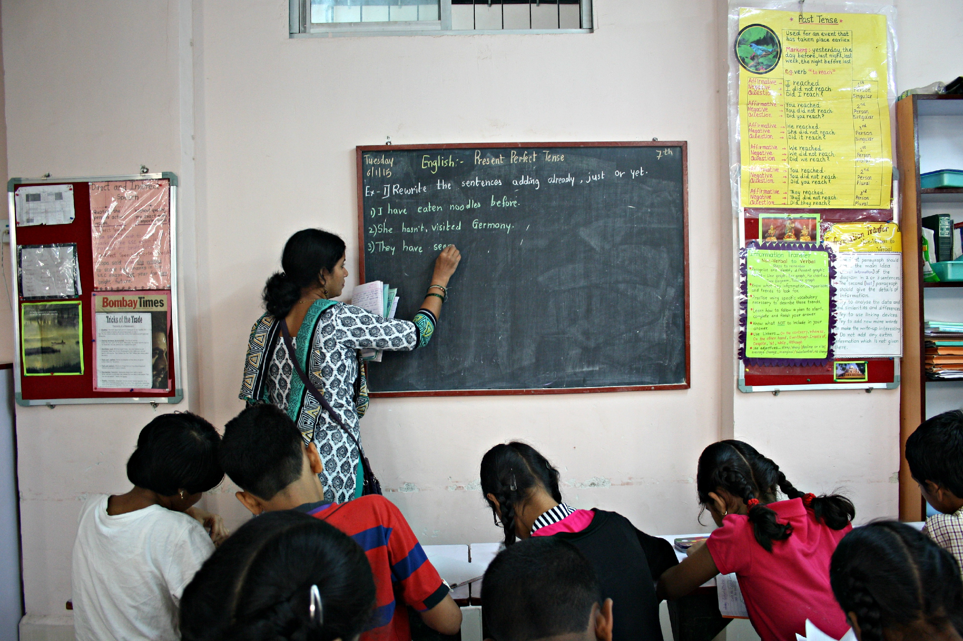

National Teacher Platform
| National Council for Teacher Education

Slide 2

Agenda
National Teacher Platform (NTP)
1
Rationale
2
About NTP
3
Current Status
4
Project Plan
Action Items and Timelines
5
6
State Action Items
| National Council for Teacher Education

Slide 3
Rationale | Landscape of Teacher Development
86%*
15%
teachers report having access to a mobile device
of Government teachers received in-service training in 2015-16
Teachers are becoming technologically savvy with instances of:
Co-creation of digital teaching content for mobile applications and web portals
Active participation in online discussion forums
Teacher trainings in Governement schools are conducted without needs assessment and are often irrelevant and outdated
Cascade model of the training does not ensure effective knowledge transfer which hampers professional growth of teachers
| National Council for Teacher Education
Notes:
Before we start speaking about the Ministry Initiative, I would like to highlight a few trends that are happening across the country. Here is a snapshot of that:
2. More and more teachers have access to smartphones. Most of the states say the penetration is as high as 80%.. Teachers are possibly the biggest representatives of WhatsApp groups sharing best practices with each other
Not only that teachers are building apps, content for each other and for children in their classrooms. I haver personally met such teachers in two states – MH and AP, and I am sure I have not seen enough.
At the same time, we have seen and heard many states rethinking how teachers are provided in-service training. They are rethinking because:
Current training structures is not reaching all the teachers; 2013-14 only 30% received mandatory training… and even for teachers who have received training, challenges of making PD specific to the needs of individual teachers have been a challenge
States are building solutions some by themselves and some in partnership with innovative NGOs to build apps for:
Teachers to collaborate and create content that all teachers can use in classroom
Observation tool that a CRC can use to do classroom observation systematically and provide teachers feedback effectively
Run fixed duration courses where teachers learn from online material and mentor teachers support them virtually
All of this is happening in not one state but many states already. …. As the Ministry observed these trends, the question for us was how do we help amplify these efoorts and what is that initiative at the national level which will allow for things to happen faster and across the country

Slide 4
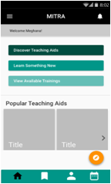
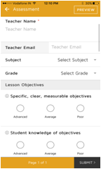
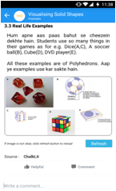
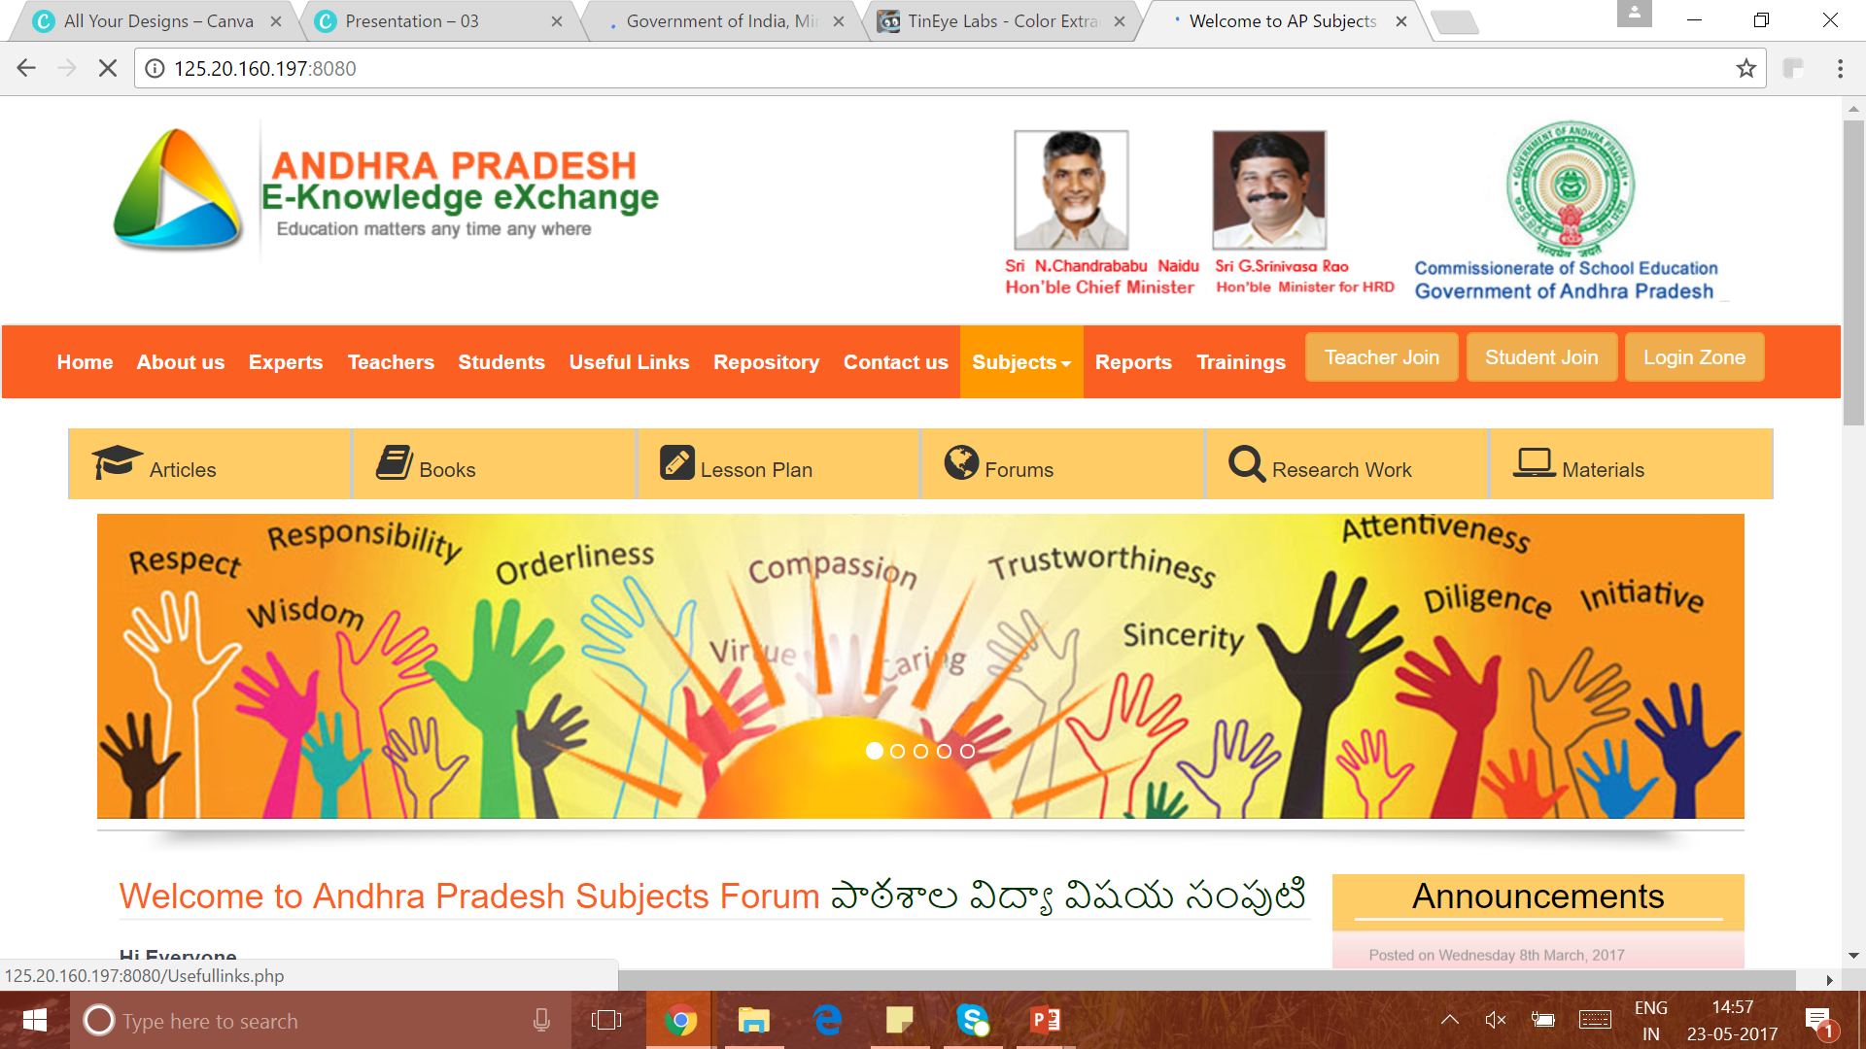
Rationale | Landscape of Teacher Development
Both Central and State Governments recognise the need of effective teacher training..
State governments have initiated programs to leverage technology to support teachers. Some of these notable programs include:
MITRA App (Maharashtra)
Observation App (Delhi, Pune, Chennai)
ChalkLit (Delhi)
APEKX Portal
(Andhra Pradesh)
| National Council for Teacher Education
Notes:
Before we start speaking about the Ministry Initiative, I would like to highlight a few trends that are happening across the country. Here is a snapshot of that:
2. More and more teachers have access to smartphones. Most of the states say the penetration is as high as 80%.. Teachers are possibly the biggest representatives of WhatsApp groups sharing best practices with each other
Not only that teachers are building apps, content for each other and for children in their classrooms. I haver personally met such teachers in two states – MH and AP, and I am sure I have not seen enough.
At the same time, we have seen and heard many states rethinking how teachers are provided in-service training. They are rethinking because:
Current training structures is not reaching all the teachers; 2013-14 only 30% received mandatory training… and even for teachers who have received training, challenges of making PD specific to the needs of individual teachers have been a challenge
States are building solutions some by themselves and some in partnership with innovative NGOs to build apps for:
Teachers to collaborate and create content that all teachers can use in classroom
Observation tool that a CRC can use to do classroom observation systematically and provide teachers feedback effectively
Run fixed duration courses where teachers learn from online material and mentor teachers support them virtually
All of this is happening in not one state but many states already. …. As the Ministry observed these trends, the question for us was how do we help amplify these efoorts and what is that initiative at the national level which will allow for things to happen faster and across the country

Slide 5
Opportunity | National Teacher Platform
About
In view of the current scenario National Teacher Platform provides a solution which:
Amplifies and leverages existing initiatives
Ensures autonomy to states to extend the platform suiting their needs
Facilitates nation wide access through the Center and State Government collaboration
1
2
3
Addresses:
Duplication of technology efforts
Flexibility in pace of adoption
Interoperability with other systems
Diversity and innovation
Duplication of resource
| National Council for Teacher Education
Notes:
In consultation with a few states, Ministry has conceptualized the idea to launch a shared platform at the national level. The platform will be built in such a manner that will address …An important point to reemphasize is that this will be a national effort – a collaboration between center and state whereby center will build the common infrastructure and states can extend it to meet their needs and take it to their teachers
Amplify the existing initiatives
Spread across the country
State the flexibility an autonomy
Thus NTP as the design

Slide 6
Opportunity | National Teacher Platform Design
An open, shared, extensible infrastructure with exemplar OER
State Platforms built as an extension of National Platform to cater to teachers directly
SOLUTIONS
Block and Cluster Innovations
State Platforms and Solutions
INFRASTRUCTURE
National Platform
| National Council for Teacher Education
Notes:
In consultation with a few states, Ministry has conceptualized the idea to launch a shared platform at the national level. The platform will be built in such a manner that will address …An important point to reemphasize is that this will be a national effort – a collaboration between center and state whereby center will build the common infrastructure and states can extend it to meet their needs and take it to their teachers
Amplify the existing initiatives
Spread across the country
State the flexibility an autonomy
Thus NTP as the design

Slide 7
About NTP | Mission
A multi-year, multi-stakeholder initiative to improve
Attitude, Skills and Knowledge
of
Teachers
in schools
Student Teachers
in TEIs
Teacher Educators
in TEIs
| National Council for Teacher Education
Notes:
Mhrd did a workshop on march 9 inviting prticpaton and contribution from different stakeholders: teaher training organiation, states, digital content, technology partners…
There was an overwhelming response and on March 31, a decision was notified to build NTP as an MHRD initiative under NCTE … NCTE has conceptualised his for these three stakeholders.

Slide 8
About NTP | Content in Phase 1
Curricular-linked Teaching Content
Competency-aligned Teacher Development Content
Types of content:
Planning and classroom reference content
Student assignments and assessments
Openly licensed content
Tagged by learning indicators, curriculum etc
Types of content:
TET prep/certification
Refresher training/recertification
PD for career progression
Bite-sized resources and Courses
Openly licensed
Tagged by teacher competencies
| National Council for Teacher Education
Notes:
Teacher Development is facilitated by a combination of activities. Content is one of them but an important one. We are spending time thinking about what that content is. For now, there are two types of content that we need to immediately provide our teachers.
One content types is the Curriculum-linked Teaching Content. The content that can help teachers to prepare for class sessions better. These could be lesson plans linked to each chapter, these could be videos on how to teach a particular topic such as mixed fraction, an interactive of where students may face difficulty (as Mr. Srikanth was showing us yesterday) and question bank that can help teachers to generate worksheets and assignments for children. The platform will have the capability to tag all content to curriculum, learning indicators etc.
Two types of content st doc

Slide 9
About NTP | Key Features
Content Authoring and Workflow
Assessments Generation
Teacher
Incentivization
1
Create and curate content of all types
2
Formative and summative assessment
3
Gamified indicators, leader boards etc.
Self- Assessment and Evaluation
Course Management
4
Classroom observation, needs assessment and self-assessment tools
5
Configurable tools for managing courses and teacher participation
Communities of Practice
Teacher Profile and Registry
Data Analytics
6
Discussion forums for teachers
7
Individual profile and private workspace for teachers
8
Dashboards to capture usage data and provide recommendations
| National Council for Teacher Education
Notes:
In addition to the two content types, we are building the following features:
Content authoring so that anyone can create and curate content. Infact MH is already using this platform and about 150 teachers are creating elementary content in three subjects
Teachers should be able to generate student assessment and in the next phase even conduct student assessment on the platform
Course management – fixed duration, long duration. Andhra Pradesh recently tested a course building on the alpha version of the platform
Also very important is a workspace for teachers which allows teachers to create a public profile but also own a private workspace where they can have their own libraries
Refer doc

Slide 10
About NTP | Technical Architecture
State Portals
& Apps
3rd Party Apps
NTP Portal
(Default Website)
NTP App
(Default App)
National Teacher Platform
Video Sharing
(YouTube, etc.)
File Sharing
(Dropbox, Drive, etc.)
EkStep
...
Aadhaar, Locker, UPI
Cloud, Mobile, Internet
| National Council for Teacher Education
Notes:
Slide in may 10th deck (ekstep) refer/modify (architecture and option slides)

Slide 11
Project Plan | Centre-State collaboration
CENTRE
STATE
1
2
3
Implementation
Design
Build
Implementation
From inception of this project, States have been involved in giving inputs on the design of the base infrastructure
Assistance from Project Management Unit at the central level in strategizing adoption plan and in evangelising the state variant of the platform amongst the final users
Platform will enable states to reconfigure and repurpose based on their local teacher training requirements
| National Council for Teacher Education
Notes:
Centre state partnership
PMU functions:
Content tech and state adoption/ implementation
design
BUILD phase
Implemetation

Slide 12
Project Plan | Centre-State collaboration
CENTRE
STATE
1
States set up state-level PMUs
1
NCTE to set up PMU for NTP
PMU creates content, technology and dissemination strategy
Create content, technology and outreach strategies
2
2
Work with SCERT, DIETs to build STP using NTP architecture
PMU works with Technology and Content Partners to launch NTP
3
3
PMU to help states create State Teacher Platforms
Test content and platform features
4
4
| National Council for Teacher Education
Notes:
Centre state partnership
PMU functions:
Content tech and state adoption/ implementation
design
BUILD phase
Implemetation

Slide 13
Action Items & Timelines
NCTE
Alpha testing of platform
May 2017
3 states go live on NTP
By 5 September 2017
1
2
3
4
5
Strategy Paper
May 2017
Beta launch of NTP
By July 2017
More states onboard on NTP – Phase 2 States
By January 2018
| National Council for Teacher Education
Notes:
Timeline format

Slide 14
Action Items & Timelines
States & Union Territories – Phase 2
Set up Project Management Unit (PMU)
By July 2017
Build content & on-field capabilities for states
5 September onwards
State Outreach
March 2018 onwards
1
2
3
4
5
6
Give feedback on NTP Strategy & Approach Document
30 May 2017
Create Content, Technology & Outreach strategies
By August 2017
States go live with content & training modules
By January 2018
| National Council for Teacher Education
Notes:
Timeline format

Slide 15
Discussion Points
What are some other content and feature requirements that National Teacher Platform should build for?
What are some ways that state governments can incentivize teachers to benefit from and contribute to this platform?
Central PMU team at NCTE will work closely with state departments to launch their platforms. What would be some ideas to make this partnership effective?
1
2
3
| National Council for Teacher Education

Slide 16
National Council for Teacher Education
For further information:
011-23370178 (Off.) 011-23379980 (Fax) E-mail : ms@ncte-india.org
Website: www.ncte-india.org/ncte_new/
Address: NCTE, Hans Bhawan, Wing II, 1, Bahadur Shah Zafar Marg, New Delhi – 110 002

Slide 17
Thank You
For more information please contact
ms@ncte-india.org
| National Council for Teacher Education
Website: www.mhrd.gov.in | Facebook: /HRDMinistry | Twitter: @HRDMinistry

